Slide 1

CoolTShirts – Marketing Attribution
Analyze User Journey
Analyze Data with SQL
Ahmad Bassel
2024-10-30

Slide 2
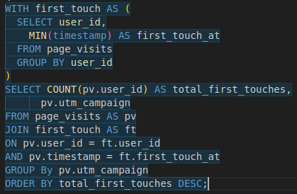
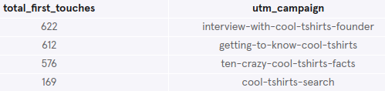
1. First Touches
The relation between each campaign and the resulted
first touches per campaign were analyzed using the query:
The results of the query showed that both interview-with-cool-tshirts-founder and getting-to-know-cool-tshirts campaigns
were responsible for the most new visits to the website:

Slide 3
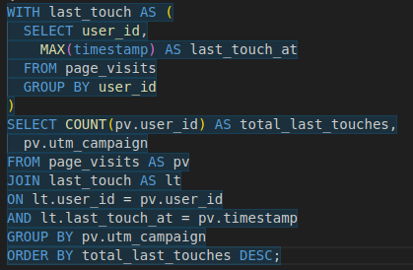
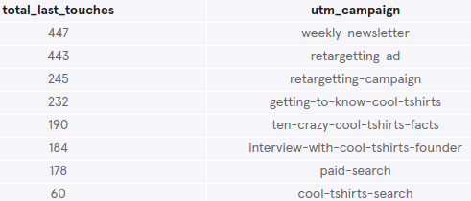
2. Last Touches
The relation between each campaign and the resulted
last touches per campaign were analyzed using the
query:
On the contrary to first touches, the results of the query showed that both weekly-newsletter and retargetting-ad campaigns were responsible for the most last touches to the website:

Slide 4
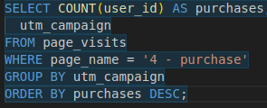
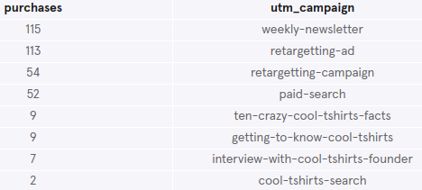
3. Purchase
The relation between each campaign and the resulted
purchase touches per campaign were analyzed using the
query:
In accordance with last touches analysis, the results of the query showed that both weekly-newsletter and retargetting-ad campaigns were responsible for the most last purchase touches on the website:

Slide 5
4. Conclusion
The company should invest more in the weekly newsletter and in the re-targetting ads for users who didn’t complete the churn from first touch to purchase.

